Slide 1


myMandarin
Kevin Thomas ‘13, Yifan Ge ‘14
Notes:
http://www.scribd.com/doc/78843182/Guy-Kawasaki-Pitch-Outline-Example

Slide 2
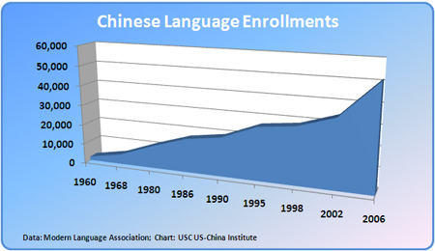
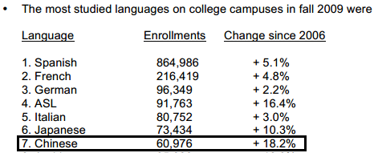
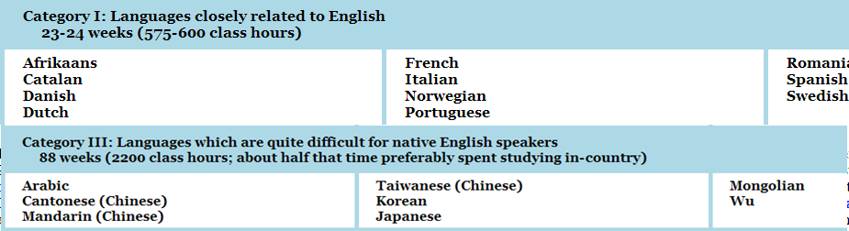

Some Facts About Chinese
MLA: Exponential Growing Enrollment
MLA: Fastest Growing Most-Studied Language
ACTFL: # of learners in K-12 is tripled from 05 to 08
FSI: Category III Language (Hardest)
CLTA:
Teachers are striving to have software assistance
Notes:
MLA: Modern Language Association
ACTEL: American Council on the Teaching of Foreign Languages
FSI: Foreign Service Institute

Slide 3
Problems
None Focus on Mandarin
Mandarin part of large software suite
Lack of Academic Software
None target classroom instruction
No Interactive Learning Experience
Mediocre Real-time Feedback

Slide 4
Our Solutions
Real Time Feedback:
Voice Recognition
Academic Focused:
Course Customization
Homework Management System
Interactive Programs
Online Voice Chat Software
Online Classes Led by Professor/TA

Slide 5
Feasibility
Hosted on Google App Engine
Programmed in HTML5
Use Google APIs for Voice Recognition
Work with Bucknell Chinese Department for initial course development and feedback

Slide 6
Business Model & Sales
Software as a Service (SaaS)
Revenue from licenses
Charge per student user
Work with Language Departments Directly
No Consumer Marketing
Hire sales representatives to travel to Universities

Slide 7
Financial Projection
 | Year 1 | Year 2 | Year 3 | Year 4 | Year 5
# of customers | 0 | 100 | 500 | 5000 | 10000
# of employees | 2 | 6 | 10 | 12 | 14
Revenue | $ - | $ 50,000.00 | $200,000.00 | $1,000,000.00 | $5,000,000.00
Expenses | $ 25,000.00 | $100,000.00 | $200,000.00 | $ 450,000.00 | $ 600,000.00
Profit | $(25,000.00) | $ (50,000.00) | $ - | $ 550,000.00 | $4,400,000.00

Slide 8
Management Team
Kevin Thomas
Computer Engineer
Beginning Mandarin
Amy ROTC Cadet
Yifan Ge
Computer Science & Electrical Engineering
ILTM Alumnus
Bilingual: English, Mandarin

Slide 9
Questions

Slide 10
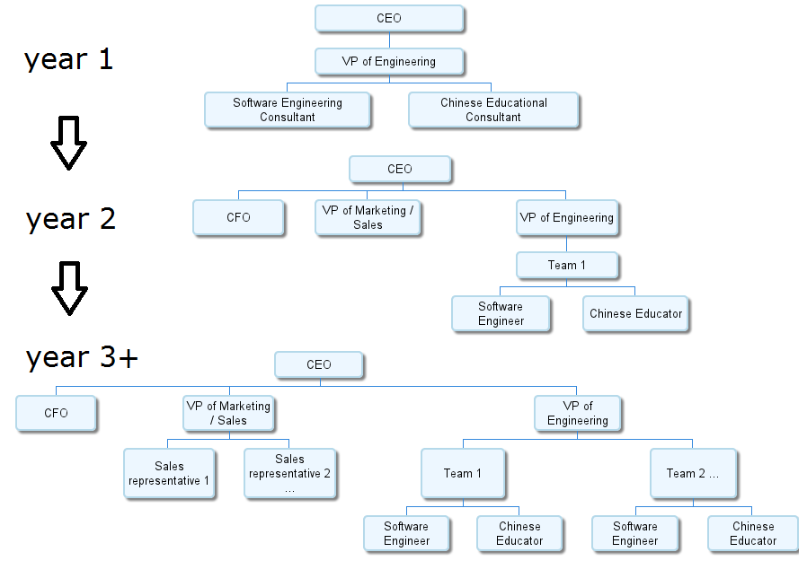
Management Team

